Slide 1
DEEP LEARNING PROJECT
Fashion-MNIST Image Classification
Convolutional Neural Networks vs. Fully-Connected Networks
Built in PyTorch • 10-Class Clothing Classification • 60,000 Images
Fashion-MNIST Image Classification — CNN vs ANN
1

Slide 2
PROJECT OBJECTIVE
Can a CNN outperform a standard neural network
at recognizing clothing?
1
2
3
Build
Compare
Explain
Two PyTorch classifiers — a fully-connected ANN baseline and a Convolutional Neural Network — trained on identical data splits.
Evaluate both on accuracy, precision, recall, F1 score, training time, and parameter count.
Visualize learning curves, confusion matrices, and misclassified samples to understand where and why each model fails.
Fashion-MNIST Image Classification — CNN vs ANN
2

Slide 3
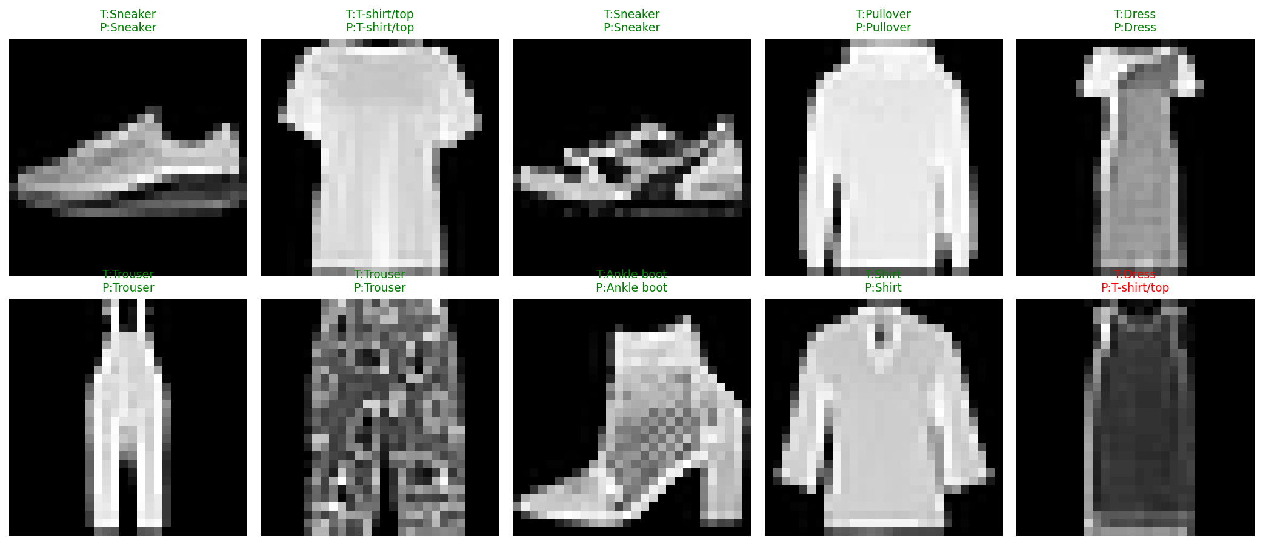
THE DATASET
Fashion-MNIST
60,000
28 × 28
labeled grayscale images
pixels per image
10
75 / 10 / 15
clothing categories
train / val / test split (%)
Class labels
Sample test images with CNN predictions (green = correct)
T-shirt/top
Trouser
Pullover
Dress
Coat
Sandal
Shirt
Sneaker
Bag
Ankle boot
Fashion-MNIST Image Classification — CNN vs ANN
3

Slide 4
DATA PIPELINE
Preprocessing & Augmentation
01
02
03
04
Load & Reshape
Stratified Split
Normalize
Augment (train only)
Parse CSV (label + 784 pixel columns) and reshape each row to a 28×28 image.
75% train / 10% validation / 15% test, stratified by class to preserve balance.
Scale pixel intensities from [0, 255] to [0, 1] for stable gradient descent.
Random horizontal flip + small random pixel shift to improve generalization.
→
→
→
Fashion-MNIST Image Classification — CNN vs ANN
4

Slide 5
MODEL ARCHITECTURES
ANN Baseline vs. CNN
ANN (Fully Connected)
CNN (Convolutional)
Flatten (784)
Conv 1→32 (3×3) → BN → ReLU → MaxPool
FC 512 → ReLU → Dropout
Conv 32→64 (3×3) → BN → ReLU → MaxPool
FC 256 → ReLU → Dropout
Flatten (64×7×7)
FC 128 → ReLU
FC 128 → ReLU → Dropout
FC 10 (output)
FC 10 (output)
Fashion-MNIST Image Classification — CNN vs ANN
5

Slide 6
TRAINING SETUP
Hyperparameters & Protocol
Loss function
Cross-Entropy Loss
Fair Comparison
Optimizer
Adam
Both the ANN and the CNN are trained with identical data splits, batch size, optimizer, learning rate, and epoch count — isolating architecture as the only variable that differs between them.
Learning rate
0.001
Batch size
128
Epochs
10
Class balance is preserved through stratified splitting, and light augmentation (flip + shift) is applied only to the training set — never to validation or test data.
Device
CPU / GPU (auto-detected)
Fashion-MNIST Image Classification — CNN vs ANN
6

Slide 7
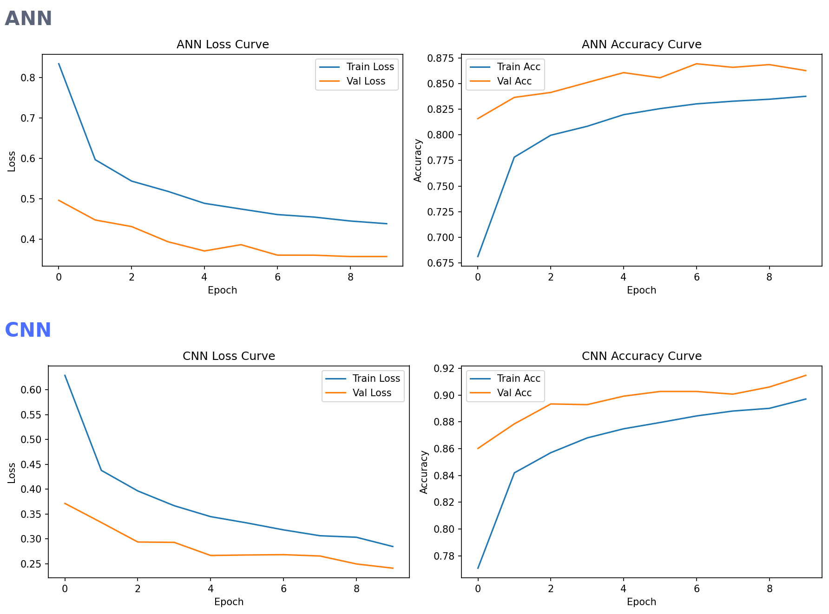
LEARNING CURVES
Training vs. Validation, Over 10 Epochs
Faster convergence
The CNN's validation loss drops below the ANN's within 2 epochs and keeps falling.
Less overfitting
CNN train/val curves stay close together; the ANN's val accuracy plateaus earlier.
Higher ceiling
CNN validation accuracy reaches ~91%, versus ~86% for the ANN, by epoch 10.
Fashion-MNIST Image Classification — CNN vs ANN
7

Slide 8
RESULTS
Performance Comparison
Metric | ANN | CNN
Test Accuracy | 86.69% | 91.51%
Precision (macro) | 87.37% | 91.51%
Recall (macro) | 86.69% | 91.51%
F1 Score (macro) | 86.41% | 91.49%
Training Time | 58.7 s | 336.0 s
Parameters | 567,434 | 421,834
+4.82 pts
Accuracy improvement of CNN over ANN
26% fewer
parameters than the ANN, despite higher accuracy — convolution shares weights spatially.
Fashion-MNIST Image Classification — CNN vs ANN
8

Slide 9
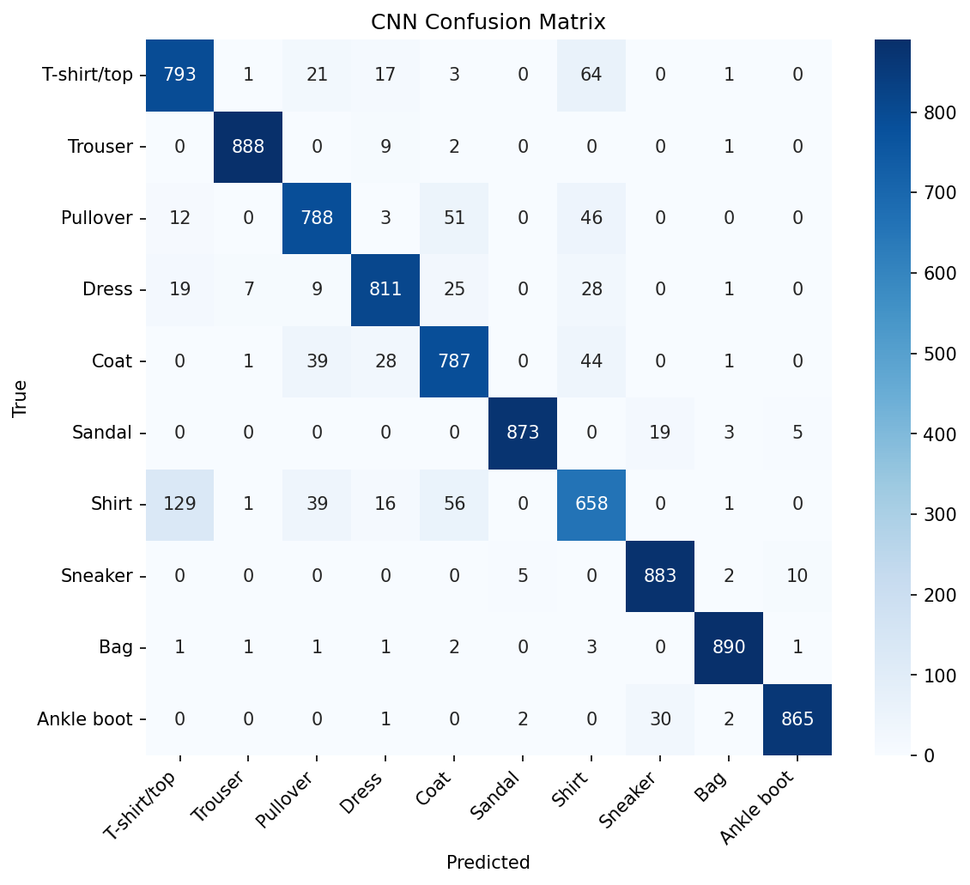
ERROR ANALYSIS
Where the CNN Still Gets Confused
Shirt is the hardest class
129 shirts were misclassified as T-shirts, and 56 as coats — the CNN struggles most where garments share silhouette and texture at low resolution.
Upper-body garments overlap
Pullover, Coat, and Dress also confuse with each other more than with footwear or bags — the strongest diagonal is on Trouser, Sandal, Sneaker, and Bag.
Fashion-MNIST Image Classification — CNN vs ANN
9

Slide 10
CONCLUSION
CNNs Win — With Fewer Parameters
The CNN beat the ANN baseline on every metric — accuracy, precision, recall, and F1 — while using 26% fewer parameters.
Next Steps
Convolution + pooling captures local spatial patterns (edges, textures, shapes) that a flattened fully-connected network cannot exploit directly.
› Deeper CNN / residual blocks
› Learning-rate scheduling
The extra training time (336s vs 59s) is a reasonable trade for a meaningfully more accurate and more efficient model.
› Test-time augmentation
› Class-weighted loss for Shirt
Deliverables: trained CNN (.pth) · comparison table (.csv) · training/validation plots · this presentation
Fashion-MNIST Image Classification — CNN vs ANN
10

